Slide 1
F1NANCE Use Sequence Diagrams

Slide 2
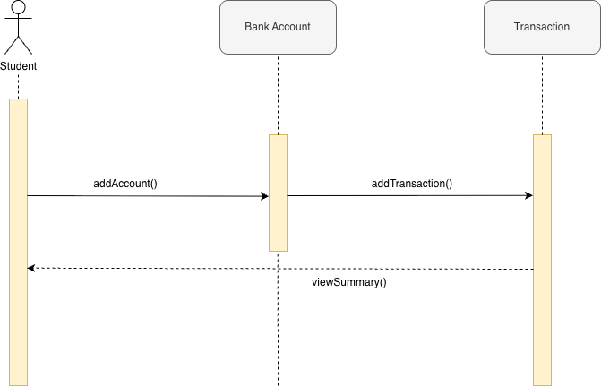
Track Income & Expenses
F1NANCE Sequence Diagrams
Use Case Scenario
This Use case begins when the User enables bank account linking.
The System fetches transaction data from the database or external bank APIs.
The System categorizes each transaction into defined expense and income types.
The System calculates total income, total expenses, and savings for the selected period.
The Use Case ends when the User views the categorized financial summary on the dashboard.

Slide 3
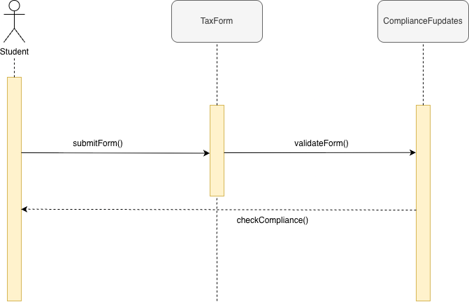
Manage Tax Guides
F1NANCE Sequence Diagrams
Use Case Scenario
This Use case begins when the User uploads or submits a tax form.
The System verifies the file format and completeness and validates entered data fields.
The System checks compliance rules against the latest stored regulations.
If any inconsistencies or missing information are found, the System displays corresponding error messages.
If all fields are valid and compliant, the System marks the tax form as “Verified.”
The Use Case ends when the User receives confirmation of validation or a list of required corrections.

Slide 4
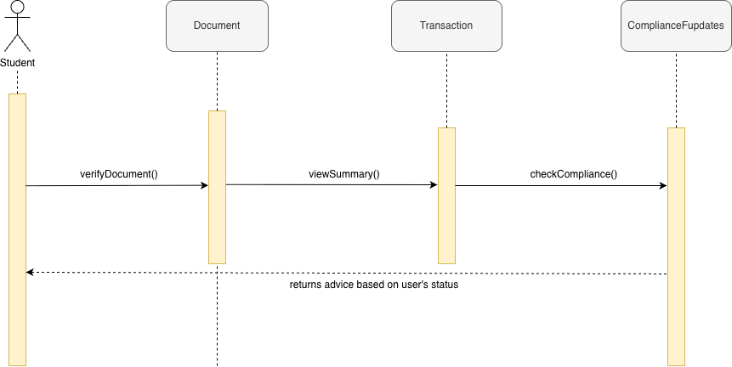
Get Financial Coaching
F1NANCE Sequence Diagrams
Use Case Scenario
This Use case begins when the User requests financial coaching or opens the “AI Advising” section.
The System retrieves the User’s transaction history, income data, and spending trends.
The AI Engine analyzes financial behavior using pre-trained models and identifies spending patterns.
The System generates contextual insights and personalized advice, such as savings goals or budget adjustments.
The Use Case ends when the User reviews or applies the AI-generated advice

Slide 5
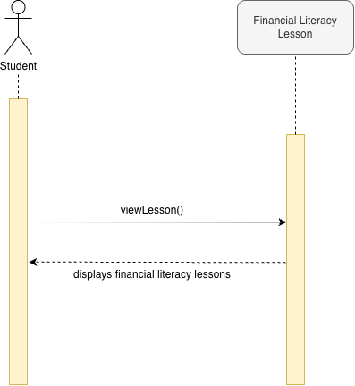
Learn Financial Literacy
F1NANCE Sequence Diagrams
Use Case Scenario
This use case begins when the User accesses the “Financial Literacy” learning section.
The System fetches available educational materials such as articles, guides, and quizzes.
The User selects a topic or module to learn about.
The System loads the selected material and tracks the User’s progress.
The Use Case ends when the User completes or exits the learning session.

Slide 6
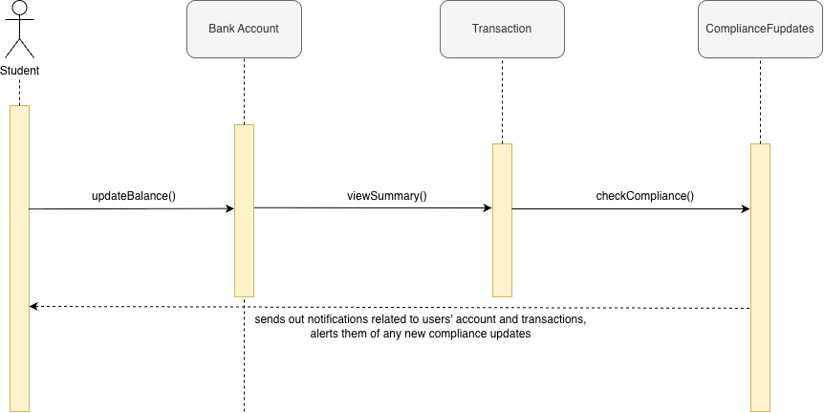
Receive Notifications
F1NANCE Sequence Diagrams
Use Case Scenario
This use case begins when the User logs into the application or when a system-triggered event (e.g., threshold reached, new advice available) occurs.
The System queries recent financial activities, deadlines, or updates related to the User’s account.
When a condition is met, the System generates a notification message containing relevant details and recommended actions.
The User views the notification through the app dashboard.
The Use Case ends when the User acknowledges or dismisses the notification.

